Slide 1
KESELAMATAN BERHENTI GLOBAL 2024
“Langkah untuk Keselamatan”

Slide 2
Komitmen Kami untuk Keselamatan
Perjalanan Keselamatan Kami
Tunggak Budaya Keselamatan Kami – Dasar Keselamatan
Tunggak Budaya Keselamatan Kami – Peraturan Menyelamatkan Nyawa
Tunggak Budaya Keselamatan Kami – Organisasi Tempat Kerja
Mencipta Budaya Keselamatan
Kepimpinan Keselamatan

Slide 3
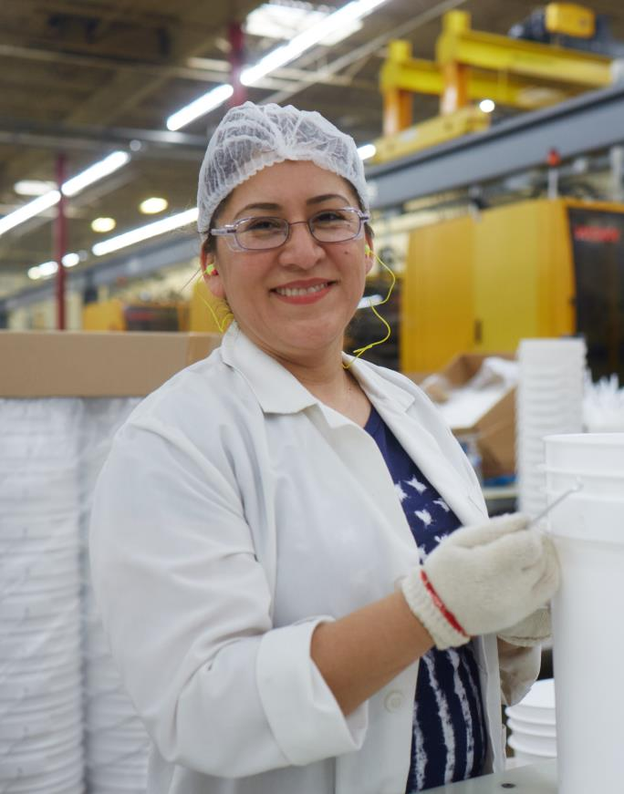
KOMITMEN KAMI KEPADA KESELAMATAN SEBAGAI NILAI TERAS
Tiada apa yang perlu dicederakan.
Semua kecederaan boleh dielakkan.
Keselamatan akan terurus.
Tingkah laku yang selamat adalah syarat pekerjaan untuk semua pekerja.
“
“
Sebagai sebuah Syarikat, adalah menjadi tanggungjawab etika kami untuk memastikan setiap pekerja pulang dengan selamat, setiap hari.
Keselamatan merupakan elemen penting dalam setiap keputusan yang kita buat.
– Mark Burgess, Presiden dan Ketua Pegawai Eksekutif
Notes:
At Mauser Packaging Solutions, we are all leaders when it comes to Safety. We all share equal responsibility for knowing and ability by our safety principles regardless of job, role or tenure.
We have a duty each and every day to remind ourselves of our core safety principles. Our core safety principles are:
Nothing is worth getting injured over.
All injuries can be prevented.
Safety will be managed.
Safe behavior is a condition of employment for all employees.

Slide 4
Keadaan Semasa
Notes:
To begin with, we will examine our current safety culture.

Slide 5
PERJALANAN KESELAMATAN KAMI
KESELAMATAN BERHENTI GLOBAL 2024
Pengurangan Semasa dari 2020
45,63%
TRIR
Jumlah Yang Boleh Dirakam
Kadar Insiden
43,43%
LTIR
Masa yang Hilang
Kadar Insiden
Langkah untuk Keselamatan
5
Notes:
Overall, Mauser Packaging Solutions is making year over year improvement regarding safety based on both leading and lagging indicators. However, we still have life altering injuries happening in the workplace.

Slide 6
Pelaburan Korporat dalam Keselamatan
Pelaburan dalam Infrastruktur Pelaburan CAPEX yang besar dibuat selama beberapa tahun untuk terus menambah baik infrastruktur keselamatan dalam kemudahan.
Pelaburan dalam Latihan Tumpuan dan pelaburan tambahan yang dibuat ke dalam program latihan keselamatan termasuk latihan pengambilan baharu dan Bengkel Penglibatan Keselamatan untuk Penyelia.
Notes:
On a corporate level, we are acting on our commitment to safety with investments in infrastructure, training and ???.
Over $XX of CAPEX investments made over the past X years that directly improve the safety infrastructure in facilities.
Additional focus and investment made into safety training programs including new hire training and Safety Engagement Workshop for Supervisors.

Slide 7
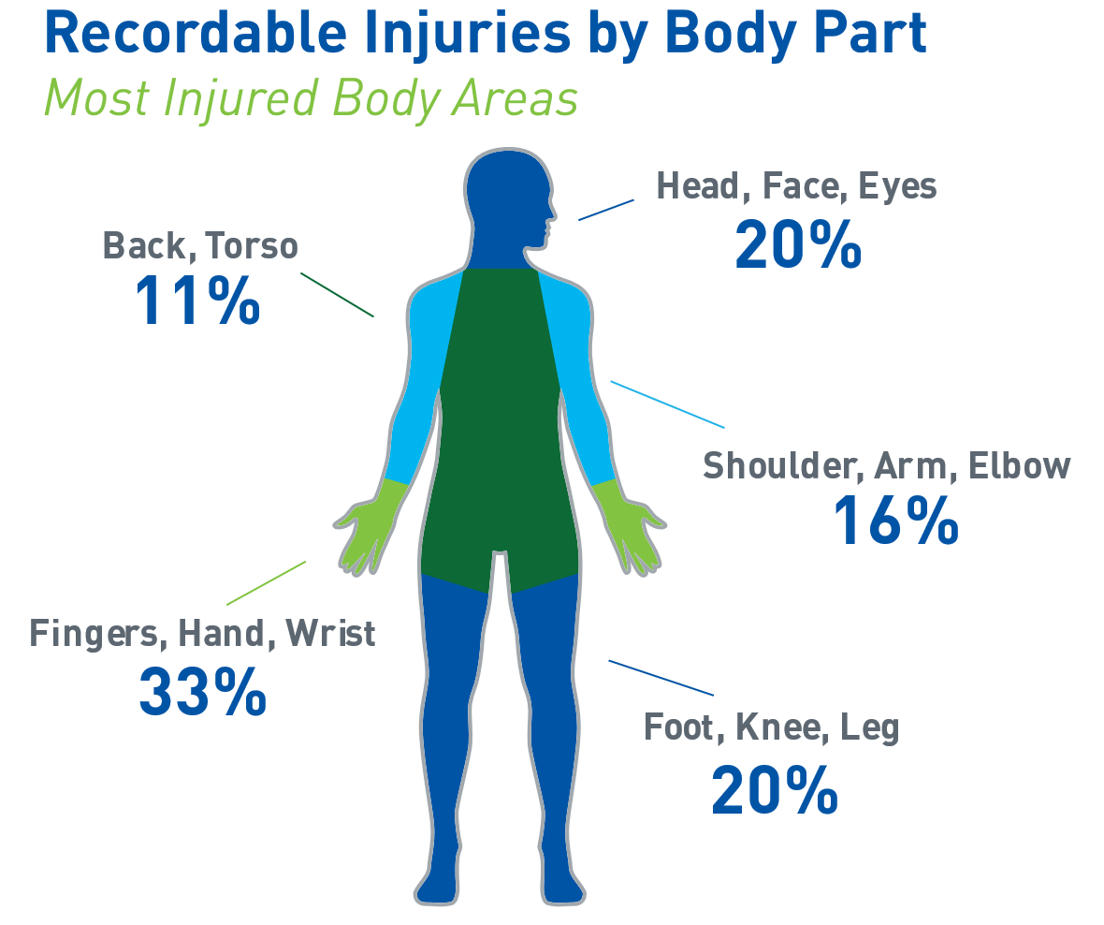
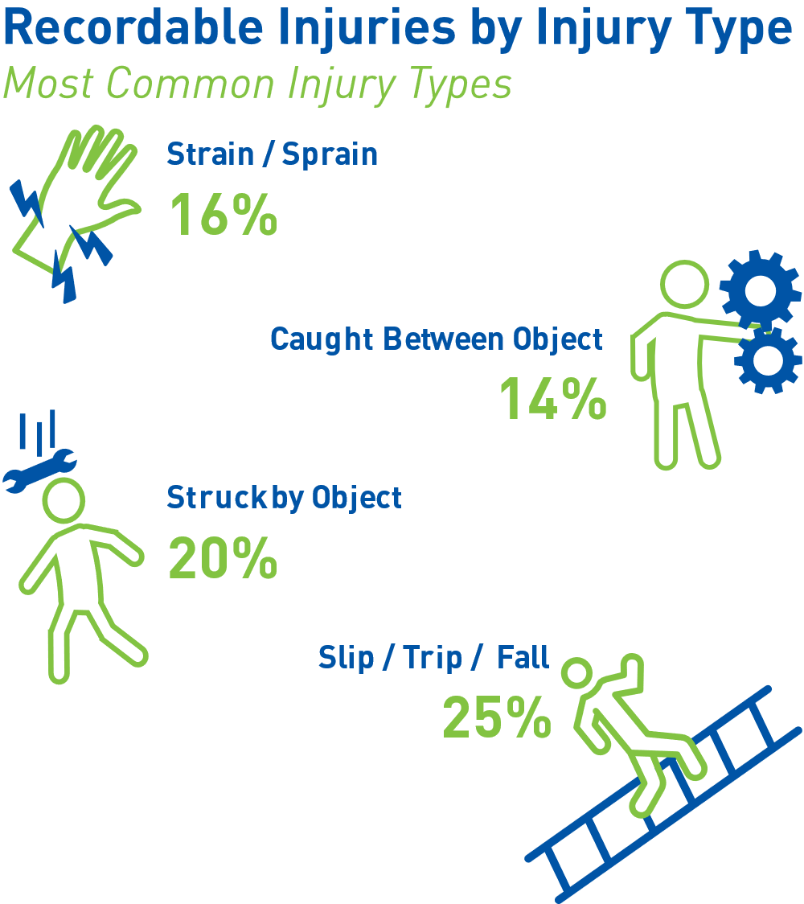
KECEDERAAN SUKU PERTAMA 2024
KESELAMATAN BERHENTI GLOBAL 2024
Kami meningkatkan perjalanan keselamatan kami, tetapi pekerja masih mengalami kecederaan yang mengubah kehidupan.
Langkah untuk Keselamatan
7
Notes:
We are improving in our safety journey, but employees are still experiencing life altering injuries.

Slide 8
Perjalanan Keselamatan Mauser
KESELAMATAN BERHENTI GLOBAL 2024
Membina Persekitaran Kerja yang Selamat
Elemen utama untuk membina dan mengekalkan persekitaran kerja yang selamat
Tempat kami bermula
Perkara yang kami lakukan
Di mana kita berada
Aturan/Peraturan Kerajaan dan Syarikat
Kawalan Kejuruteraan
Kepimpinan
Dalam tempoh lima tahun yang lalu, Mauser telah meningkatkan komitmen terhadap peraturan OSHA bersama-sama dengan memperkenalkan Peraturan Menyelamatkan Nyawa.
Fokus: Pematuhan
Beberapa tahun lalu, mengenal pasti titik pinch aset berisiko tinggi, mereka bentuk dan memasang pelindung mesin yang diperlukan.
Fokus: Penghapusan daripada Bahaya Keselamatan
Membangunkan pemimpin kita dengan tingkah laku dan tindakan untuk menyokong budaya di mana pekerja terlibat dalam keselamatan.
Fokus: Komitmen
Langkah untuk Keselamatan
8
Notes:
In the past five years, Mauser has been committed to ensuring compliance to OSHA regulations along with implementation of the Life Saving Rules to provide structure around the non-negotiable safety behaviors. We have also been investing significantly in engineering controls to provide the necessary infrastructure to protect employees from risk. But a true safety culture must begin with complete commitment from leadership in the company endorsing a culture where employees are engaged with safety. To take the next step in our safety journey, we are making a commitment at every level of the organization to prioritize safety above all other goals and objectives.

Slide 9
Tunggak Budaya Keselamatan kami
Notes:
To begin with, we will examine our current safety culture.

Slide 10
TIGA TUNGGAK BUDAYA KESELAMATAN KITA
KOMITMEN
TINGKAH LAKU
PERSEKITARAN
Dasar Keselamatan
kenyataan bertulis tentang komitmen kami terhadap keselamatan
Peraturan Menyelamatkan Nyawa
prinsip panduan tentang cara kami mengamalkan komitmen kami terhadap keselamatan
Organisasi Tempat Kerja (5S)
mewujudkan ruang di mana kerja yang selamat boleh dipraktikkan
Pemimpin keselamatan di setiap peringkat diperlukan untuk membangun dan menyokong budaya keselamatan.
Notes:
Our Safety Culture is supported by three pillars
Our Global Health and Safety policy which is the written statement of our commitment to safety
The Life Saving Rules which are the guiding principles of how we practice out commitment to safety
And Workplace Organization which creates the physical space where safe work can be practiced. A safe work environment is created through many factors including machine guarding, automation, fall protection, ventilation, noise control, lighting and more, but organization created through 5S is one area where we all have ownership and responsibility.
Undergirding these three pillars are safety leaders that are needed at every level of the organization to develop and support a safety culture. A safety culture is nothing without people who comply with it and nurture it every day.
Over the next few slides we will take a look at each of these three pillars.

Slide 11
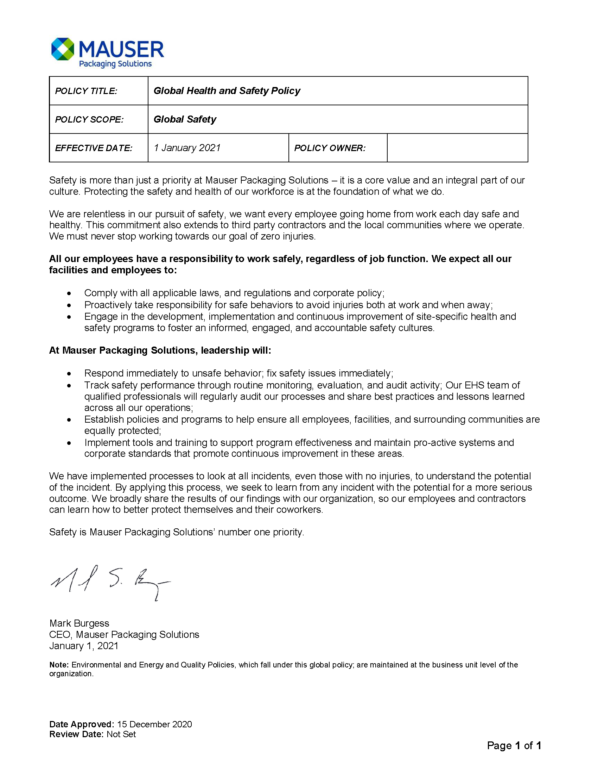
DASAR KESELAMATAN KAMI
Sorotan dasar kami:
Keselamatan ialah nilai teras, bukannya keutamaan. Tanpa henti kami mengejar keselamatan.
Bahagian penting dalam budaya kami.
Termasuk komuniti tempat kami bekerja dan kontraktor.
Tanggungjawab kami sebagai pekerja Mauser bersama-sama dengan kemudahan kami.
Akauntabiliti kepimpinan.
Proses insiden, pembelajaran dan perkembangan keselamatan kita.
Notes:
Our first pillar is our Global Health and Safety Policy.
This policy is a recognized written statement of our commitment to protect the health and safety of employees, those we work with and our community.
Highlights of our policy:
Safety is a core value, not a priority. Relentless is our pursuit of safety.
Integral part of our culture.
Includes our community in which we work and contractors.
Our responsibility as Mauser employees along with our facilities.
Leadership’s accountability.
Incident processes, learning and evolving our safety.
Employees can access our Global Health and Safety Policy on MauserNOW and on communication boards.

Slide 12
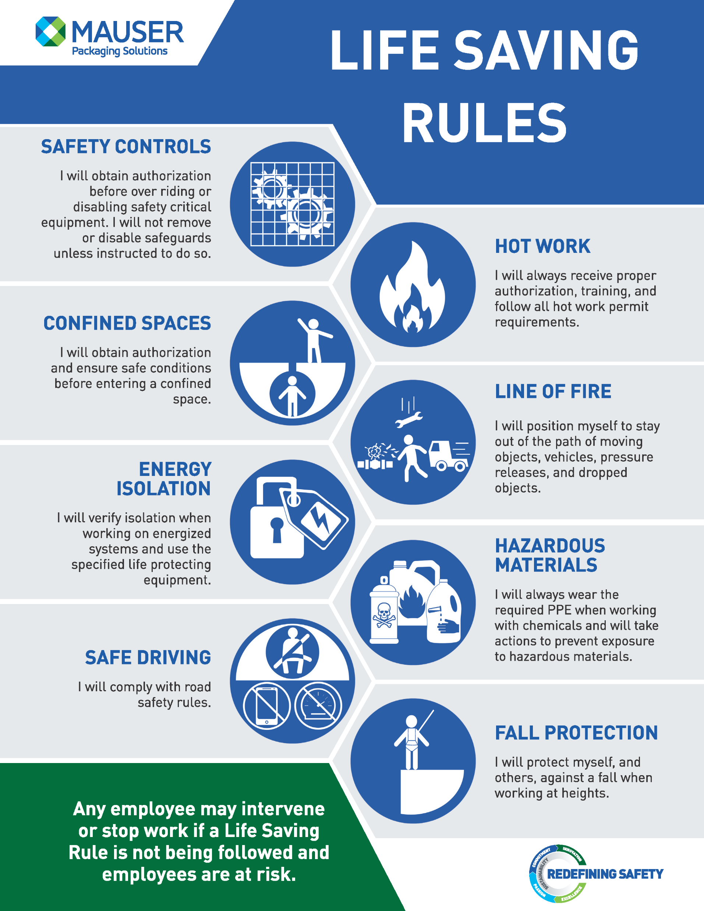
PERATURAN MENYELAMATKAN NYAWA
Peraturan Menyelamatkan Nyawa (LSR) ialah prinsip keselamatan utama yang menangani bahaya khusus untuk operasi kami melindungi kami daripada kecederaan serius atau kematian.
Notes:
The second pillar is the Life Saving Rules which are key safety principles that address hazards specific to our operations protect us against serious injury or death.
If our policy is the statement of our commitment to safety, then the Life Saving Rules are the guiding principles of how we practice this commitment.
Implemented in 2020, the Life Saving Rules provide guidance for how all employees should act when dealing with hazardous situations or circumstances

Slide 13
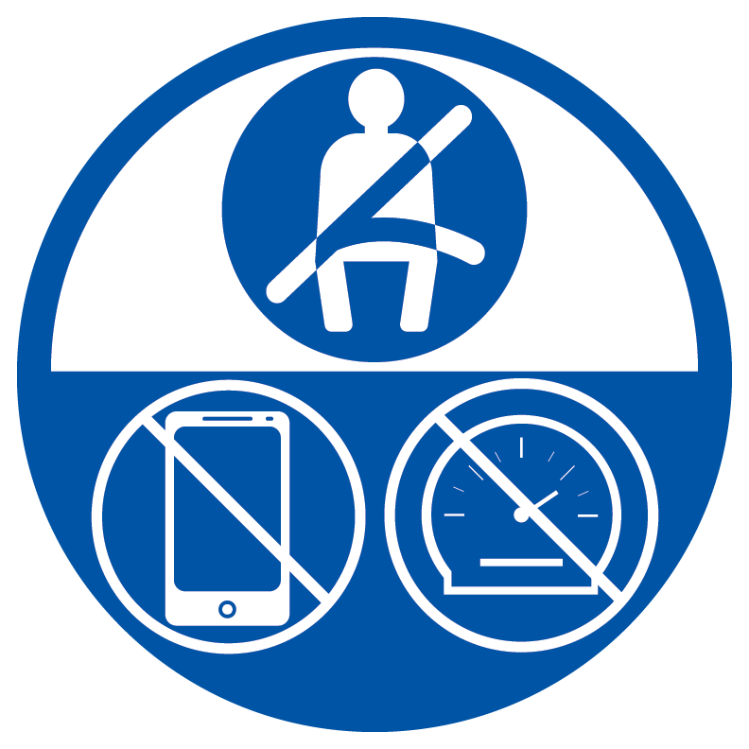
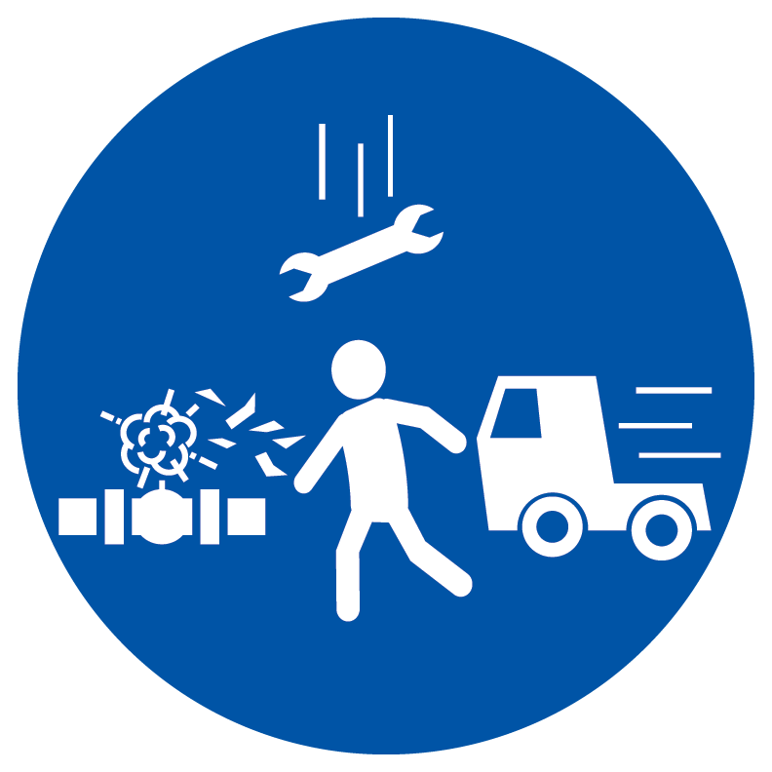
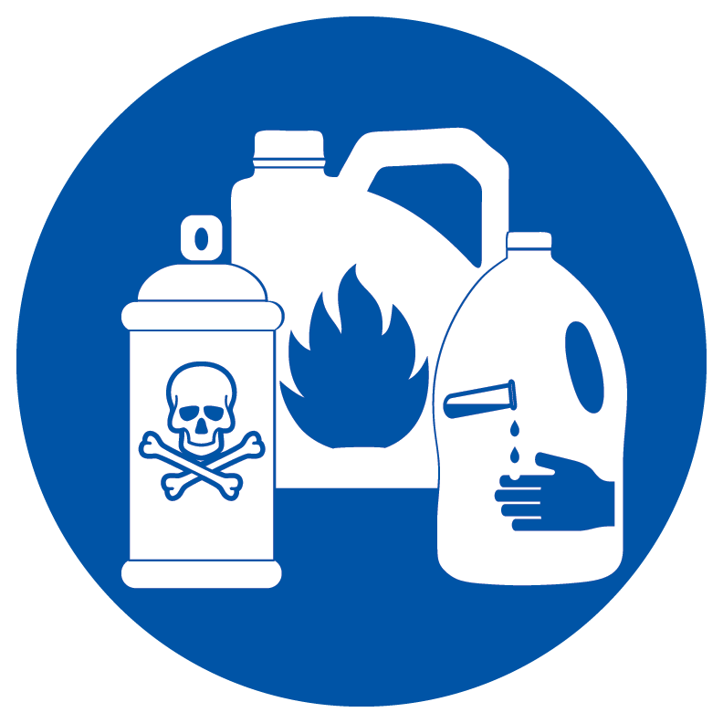
Komitmen Aktif untuk Peraturan Menyelamatkan Nyawa:
Pendidikan - Menjadi tanggungjawab anda untuk memahami Peraturan Menyelamatkan Nyawa. Jika tidak jelas, tanya!
Pematuhan kepada Peraturan Menyelamatkan Nyawa – semua orang dikehendaki mematuhi peraturan ini tanpa mengira kedudukan atau peranan pekerjaan
Penilaian Risiko -Sebelum menjalankan tugas, semak tugasan itu mengikut Peraturan Menyelamatkan Nyawa.
Intervensi - Semua orang berhak meminta operasi atau aktiviti dihentikan jika mereka percaya Peraturan Menyelamatkan Nyawa tidak dipatuhi dan pekerja berisiko.
Bekerja bersama-sama secara Aktif - Jika anda melihat rakan sekerja yang berisiko, katakan sesuatu
Kawalan Keselamatan
Ruang Terhad
Pemanduan Selamat
Pengasingan Tenaga
Kerja Panas
Barisan Api
Bahan Berbahaya
Perlindungan daripada Jatuh
Notes:
Leaders have a responsibility to create an environment that enforces these rules, but every employee has a responsibility for demonstrating behaviors and actions that adhere to the Life Saving Rules.
An active commitment to the Life Saving Rules includes:
Education - It’s your responsibility to understand the Life Saving Rules. If unclear, ask!
Adherence to the Life Saving Rules – everyone is required to follow these rules regardless of position or job role
Risk Assessment -Before conducting a task, review the task against the Life Saving Rules.
Intervention - Everyone has the right to request an operation or activity be stopped if they believe a Life Saving Rule is not being followed and employees are at risk.
Actively Working together - If you see a fellow worker at risk, say something
Life Savings Rules are not to be ignored or take on alternative meanings. They are to be respected, upheld and consistently executed. We are all responsible and accountable.

Slide 14
Pemahaman tentang Peratuan Keselamatan Nyawa (LSR)
Peraturan Keselamatan Nyawa BUKAN
Dasar keselamatan yang komprehensif
Latihan formal
Peraturan “dicekup” atau tertangkap yang digunakan untuk tindakan tatatertib sahaja
Peraturan Keselamatan Nyawa BUKAN
Peringatan untuk keadaan yang sering berlaku bahaya
Prinsip panduan untuk tingkah laku paling asas yang diperlukan bagi menangani setiap keadaan yang berisiko
Panduan untuk menetapkan tingkah laku yang akan melindungi pekerja daripada kecederaan serius atau maut Walau bagaimanapun, tahap keparahan bahaya yang dikemukakan oleh LSR memerlukan elemen tatatertib dimasukkan dalam dasar ini.

Slide 15
ORGANISASI TEMPAT KERJA – 5S
Sistem 5S ialah proses penambahbaikan berterusan untuk meningkatkan produktiviti dan meningkatkan keselamatan tempat kerja.
SORT (ishih)
Implikasi Keselamatan:
Menghapuskan halangan.
Kurang item untuk dijumpai, terlanggar, terbakar atau menyebabkan jenis kerosakan lain. Tempat kerja yang disusun rapi ialah tempat kerja yang lebih selamat.
STANDARDIZE (menstandardkan)
Implikasi Keselamatan:
Kurangkan risiko malfungsi, kemalangan dan masalah keselamatan lain.
Tempat kerja yang mengikuti proses standard telah menunjukkan persekitaran yang lebih selamat.
Jangkaan tempat kerja yang lebih besar untuk pekerja baharu.
SET IN ORDER (teratur)
Implikasi Keselamatan:
Mungkin pekerja akan mengambil item yang salah.
Menggunakan item yang salah boleh menyebabkan risiko keselamatan yang serius.
SUSTAIN (kekal)
Implikasi Keselamatan:
Lebih lama metodologi 5S diikuti dan dipertingkatkan, lebih selamat kemudahan itu.
Menanam usaha yang berterusan akan menjadi lebih selamat.
SHINE (bersinar)
Implikasi Keselamatan:
Menyapu habuk dan minyak menghilangkan bahaya kebakaran.
Membersihkan tumpahan mengurangkan risiko insiden tergelincir dan jatuh.
Notes:
The 5S System is a continuous improvement process designed to improve productivity that also improves workplace safety. For each step in the 5S System, there are specific safety implications that create a safer work environment when followed.
Sorting removes unnecessary items from the work area creating less clutter do there are fewer obstacles causing trips and falls.
Setting in Order makes it easier to access tools reducing the likelihood that incorrect items are used that cause safety risks.
Shining created a clean workspace free of dust and oil that create fire hazards and spills that can cause slips and falls.
Standardization ensures everyone performs tasks in the same manner and reinforces safe behavior.
Sustaining is the practice of continually re-evaluating the workspace and behavior to ensure the safest space possible.

Slide 16
ORGANISASI TEMPAT KERJA– 5S
Faedah ruang kerja yang tersusun:
Mengurangkan risiko kemalangan
Penggunaan masa yang lebih baik
Kurang ruang yang terbuang
Masa henti peralatan dikurangkan
Peningkatan konsistensi dan kualiti
Peningkatan akhlak
Kategori Cedera 2023
Kira-kira 41% kecederaan pada tahun 2023 berlaku dalam kategori di mana keselamatan dipertingkatkan melalui organisasi tempat kerja.
Notes:
Having a well organized and clutter-free working space lowers the risk of accidents such as slips and trips, toppling or falling objects, and exposure to hazardous materials.
More than 60% of injuries in 2021 could have potentially been prevented with workplace organization—5S program.
An organized, clean work environment speaks to safety behavior and expectations
Clutter in the workspace causes a higher risks of slips, trips and falls along with the potential of falling objects and blind walking spots.
If the work area is disorganized, cluttered or dirty, employees can question whether leadership cares about safety and whether they should care about safety.

Slide 17
Kepemimpinan Keselamatan: semua orang ada peranan untuk dimainkan.
Notes:
Having the elements of safety culture means nothing means nothing unless it is embodied and practiced by employees.
When it comes to safety everyone is a leader regardless or job role or title.

Slide 18
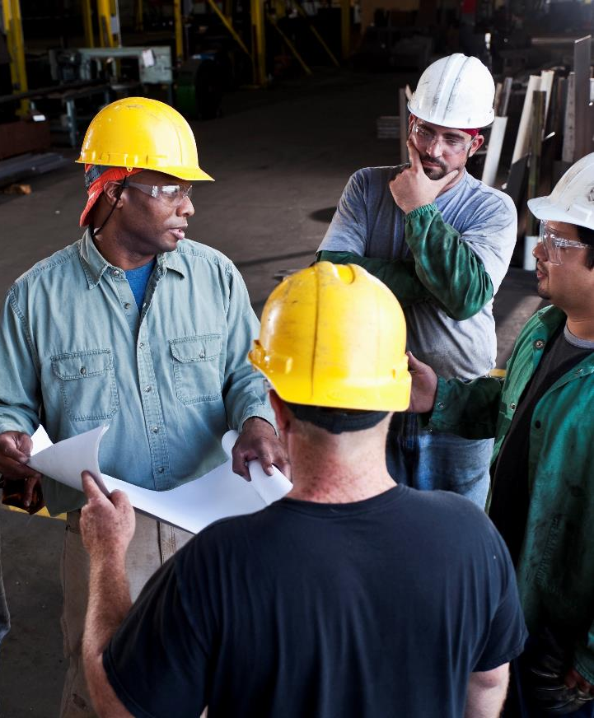
APAKAH KEPIMPINAN KESELAMATAN?
Kepimpinan keselamatan tidak semestinya menjadi seorang yang memegang peranan kepimpinan.
Pemimpin Keselamatan:
Pamerkan tingkah laku keselamatan peribadi
Memberi inspirasi yang lain
Patuhi dengan tepat protokol keselamatan
Bercakap secara membina
Mengakui pekerja bekerja dengan selamat
Mendengar kebimbangan mengenai keselamatan pekerja
Notes:
Safety leadership does not have to be a person in a leadership role (Lead hand, Supervisor, Manager).
A safety leader is somebody who not only exhibits personal safety behaviors but inspires others to do the same. These are people who not only follow safety protocols precisely but speak up in a constructive way when they see that others could be doing something in a safer manner. They acknowledge employees working safely and take time to listen to employees’ safety concern.
Having additional safety leaders results in more sustained, consistent and positive safety performance and behaviors.

Slide 19
KESELAMATAN BERHENTI GLOBAL 2024
Analisis Sebab Punca
Mengapakah penting untuk menentukan punca utama?
Betulkan perkara
Jauhi daripada menyalahkan orang
Pegang orang bertanggungjawab
Contoh:
Insiden: Menerima tiket memandu laju
Sebab?
Terperangkap memandu laju
Sebab?
Sebab?
Lewat ke tempat kerja
Sebab?
Sebab?
Terlajak tidur
Sebab?
Sebab?
Jam loceng tidak berfungsi
Sebab?
Sebab?
Bateri mati
Sebab?
Sebab?
Tidak menukar bateri
Penyelesaian: Pasang palam jam penggera atau tukar bateri sebelum kehabisan.
Langkah untuk Keselamatan
19
Notes:
When incidents happen, it is easy to lay blame on the specific circumstances and individual involved but most safety incidents have more than one attributing factor. When we examine incidents to discover root causes, we realize there are many opportunities to accept responsibility and effect change. A change in behavior or circumstances at any level of the root cause analysis, could have prevented the incident in question.
When we all accept responsibility for creating the environment or circumstances that facilitated an incident, we can effectuate meaningful change that ensures a safe workplace for everyone.

Slide 20
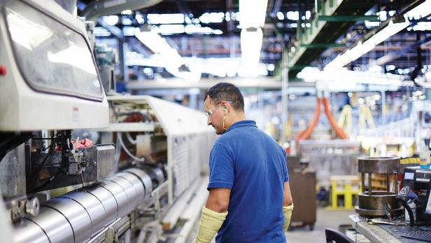
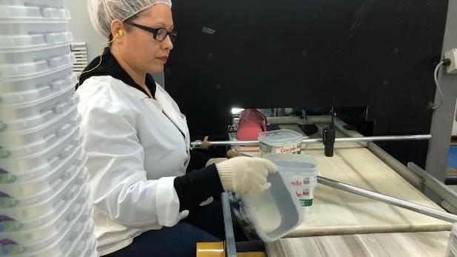
KESELAMATAN BERHENTI GLOBAL 2024
Semua orang bertanggungjawab terhadap keselamatan
Ikut prosedur
Ambil hak milik
Hak anda untuk menghentikan kerja dan melaporkan
Intervensi jika tindakan atau persekitaran nampak tidak selamat
Tanya soalan untuk menentukan sama ada situasi tidak selamat
Laporkan kepada seorang pengurus atau penyelia
Keselamatan ialah Peribadi – Bawa ke tempat kerja, bawa pulang ke rumah!
Langkah untuk Keselamatan
20
Notes:
While the building of a safety culture begins with leadership, everyone has a responsibility for the safety of ourselves and those around us. Each one of us shares the responsibility of making sure everyone goes home safe every day. We can achieve this by following the safety procedures that are in place and taking personal ownership for ensuring safety is the first element in every decision we make.
Every employee has the right and responsibility to stop work and report unsafe conditions or actions. Any employee can intervene and has the right to request an operation or activity be stopped if they believe a situation is unsafe and employees are at risk. If you are not sure, you should at report the situation to a supervisor or manager. If your “gut” is telling you something is unsafe, then it probably is.
Safety is personal. So personal that you take it take it home. When you are mowing the lawn or hanging Christmas lights, what safety example are you setting for your neighbors or kids? No matter where you are or what you are doing, safety matters.

Slide 21
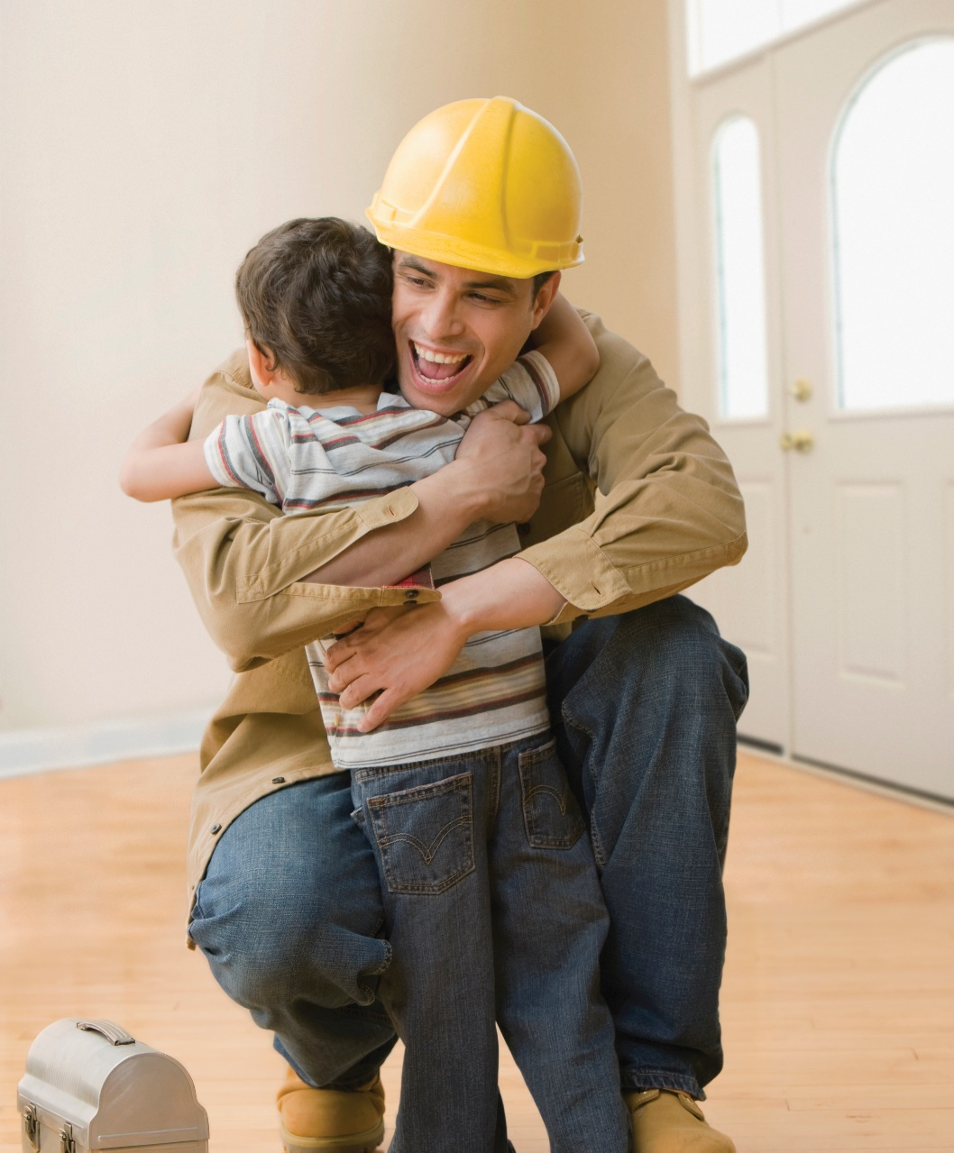
KESELAMATAN BERHENTI GLOBAL 2024
Tindakan apakah yang akan ANDA ambil?
Sudah tiba masanya untuk…
“Langkah untuk Keselamatan”
Langkah untuk Keselamatan
21
Notes:
Safety must be a commitment that is made by every employee everyday and we can all do something to improve our commitment to safety. Think about your work environment and action and make a commitment to improve or change something that will help keep you and your fellow employees safer.
You will never know the injury that is prevented when you practice safety leadership.
What actions will YOU take?

