Slide 1
2024 年全球安全停工活动
“加强安全措施”

Slide 2
我们对安全的承诺
我们的安全之旅
我们的安全文化的支柱 – 安全政策
我们的安全文化的支柱 – 救生规则
我们的安全文化的支柱 – 工作场所组织管理
创造安全文化
安全领导

Slide 3
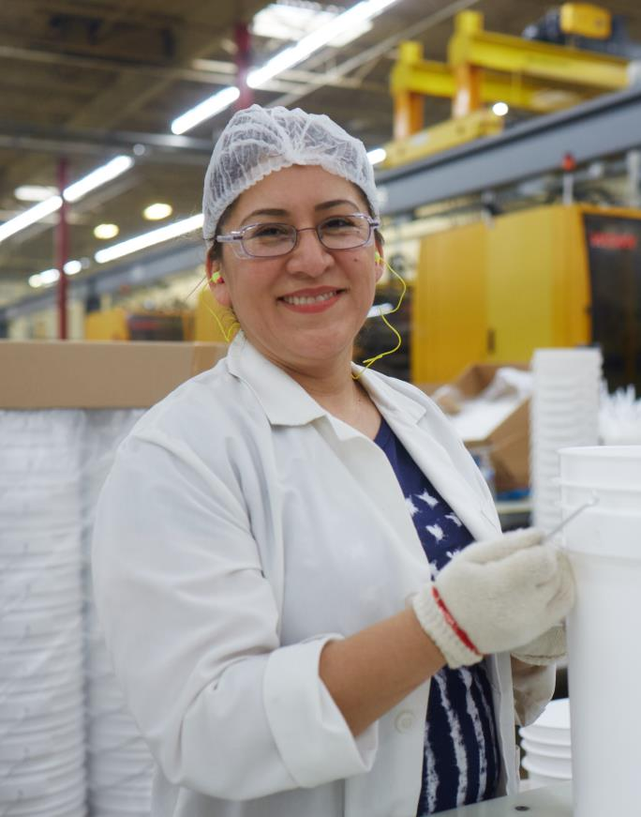
我们承诺以安全为核心价值
没有什么值得为之受伤。
所有受伤皆可以预防。
安全将得到妥善管理。
安全行为是所有员工的雇佣条件之一。
“
“
作为一家公司，确保每位员工每天安全回家是我们的道德责任。
安全是我们做出每个决定的重要考虑因素。
– 马克·伯吉斯（Mark Burgess），总裁兼首席执行官
Notes:
At Mauser Packaging Solutions, we are all leaders when it comes to Safety. We all share equal responsibility for knowing and ability by our safety principles regardless of job, role or tenure.
We have a duty each and every day to remind ourselves of our core safety principles. Our core safety principles are:
Nothing is worth getting injured over.
All injuries can be prevented.
Safety will be managed.
Safe behavior is a condition of employment for all employees.

Slide 4
当前状态
Notes:
To begin with, we will examine our current safety culture.

Slide 5
我们的安全之旅
2024 年全球安全停工活动
2020 年起的最新减少情况
45.63%
TRIR
总可记录
事故率
43.43%
LTIR
损失时间
事故率
加强安全措施
5
Notes:
Overall, Mauser Packaging Solutions is making year over year improvement regarding safety based on both leading and lagging indicators. However, we still have life altering injuries happening in the workplace.

Slide 6
企业安全投资
基础设施投资 多年来，公司进行了大量资本支出投资，直接改善了经营场所的安全基础设施。
培训投资 公司对安全培训项目给予额外的关注和投资，包括新员工培训和主管安全参与研讨会。
Notes:
On a corporate level, we are acting on our commitment to safety with investments in infrastructure, training and ???.
Over $XX of CAPEX investments made over the past X years that directly improve the safety infrastructure in facilities.
Additional focus and investment made into safety training programs including new hire training and Safety Engagement Workshop for Supervisors.

Slide 7
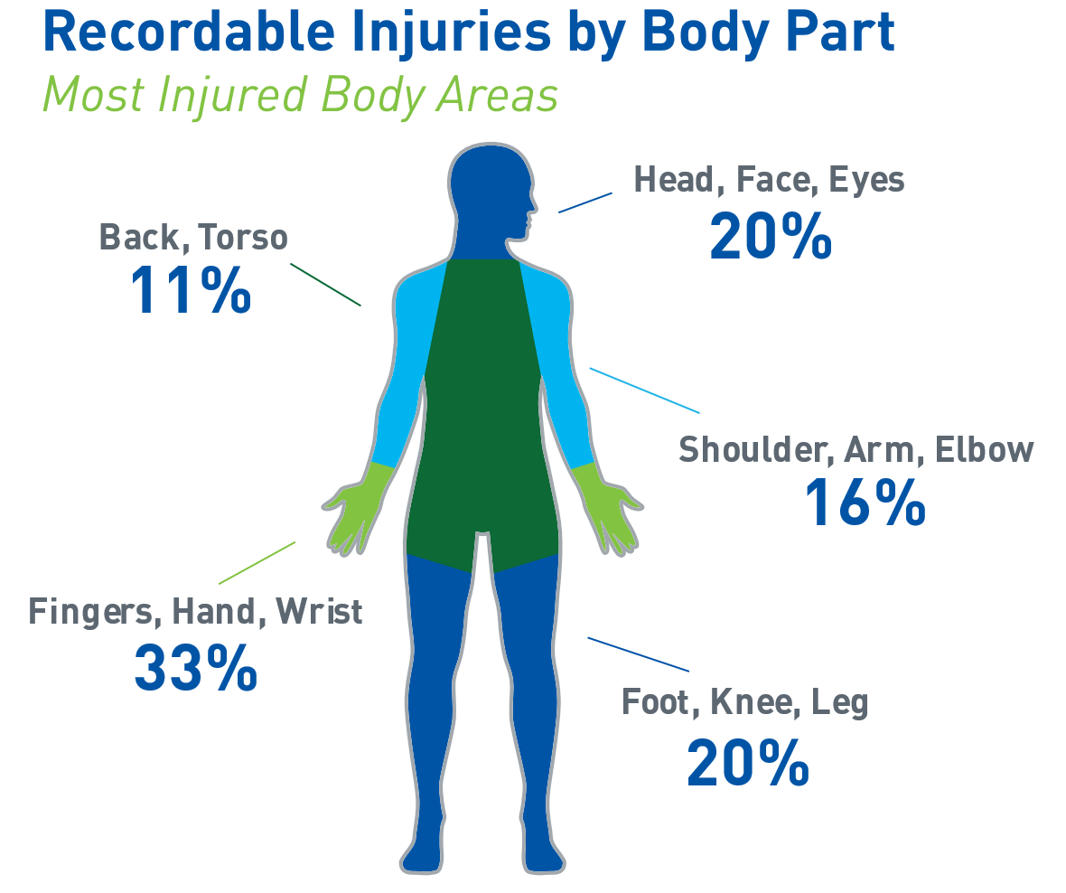
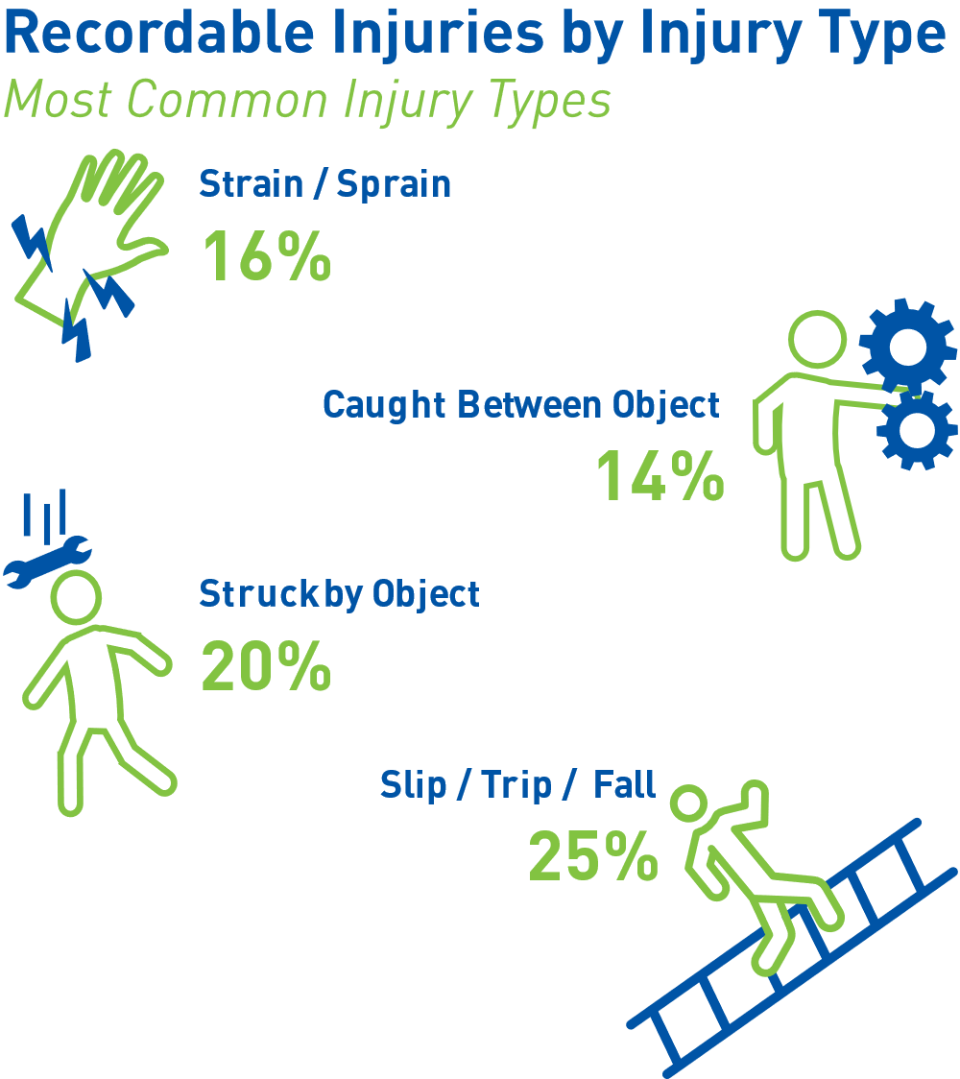
2024 年第一季度受伤情况
2024 年全球安全停工活动
我们正在改进我们的安全之旅，但员工仍在经历着影响其人生的伤害。
加强安全措施
7
Notes:
We are improving in our safety journey, but employees are still experiencing life altering injuries.

Slide 8
Mauser 的安全之旅
2024 年全球安全停工活动
营造安全的工作环境
构建和维持安全工作环境的关键要素
我们从哪里开始
我们采取的行动
我们所处位置
政府和公司规章制度
工程控制
领导
在过去五年中，Mauser 加大了遵守职业安全与健康管理局法规的承诺，同时引入了我们的救生规则。
重点： 合规性
在过去几年，公司确定了各个高风险资产关键点，并设计和安装必要的机器防护装置。
重点： 消除安全隐患
通过行为和行动培养我们的领导者，以支持吸引员工参与安全事务的文化。
重点： 承诺
加强安全措施
8
Notes:
In the past five years, Mauser has been committed to ensuring compliance to OSHA regulations along with implementation of the Life Saving Rules to provide structure around the non-negotiable safety behaviors. We have also been investing significantly in engineering controls to provide the necessary infrastructure to protect employees from risk. But a true safety culture must begin with complete commitment from leadership in the company endorsing a culture where employees are engaged with safety. To take the next step in our safety journey, we are making a commitment at every level of the organization to prioritize safety above all other goals and objectives.

Slide 9
我们安全文化的支柱
Notes:
To begin with, we will examine our current safety culture.

Slide 10
我们安全文化的三大支柱
承诺
行为
环境
安全政策
我们对安全承诺的书面声明
救生规则
我们如何实践安全承诺的指导原则
工作场所组织管理（5S）
创造一个可以安全工作的空间
组织各个层面的安全领导者都需要 培养和支持安全文化。
Notes:
Our Safety Culture is supported by three pillars
Our Global Health and Safety policy which is the written statement of our commitment to safety
The Life Saving Rules which are the guiding principles of how we practice out commitment to safety
And Workplace Organization which creates the physical space where safe work can be practiced. A safe work environment is created through many factors including machine guarding, automation, fall protection, ventilation, noise control, lighting and more, but organization created through 5S is one area where we all have ownership and responsibility.
Undergirding these three pillars are safety leaders that are needed at every level of the organization to develop and support a safety culture. A safety culture is nothing without people who comply with it and nurture it every day.
Over the next few slides we will take a look at each of these three pillars.

Slide 11
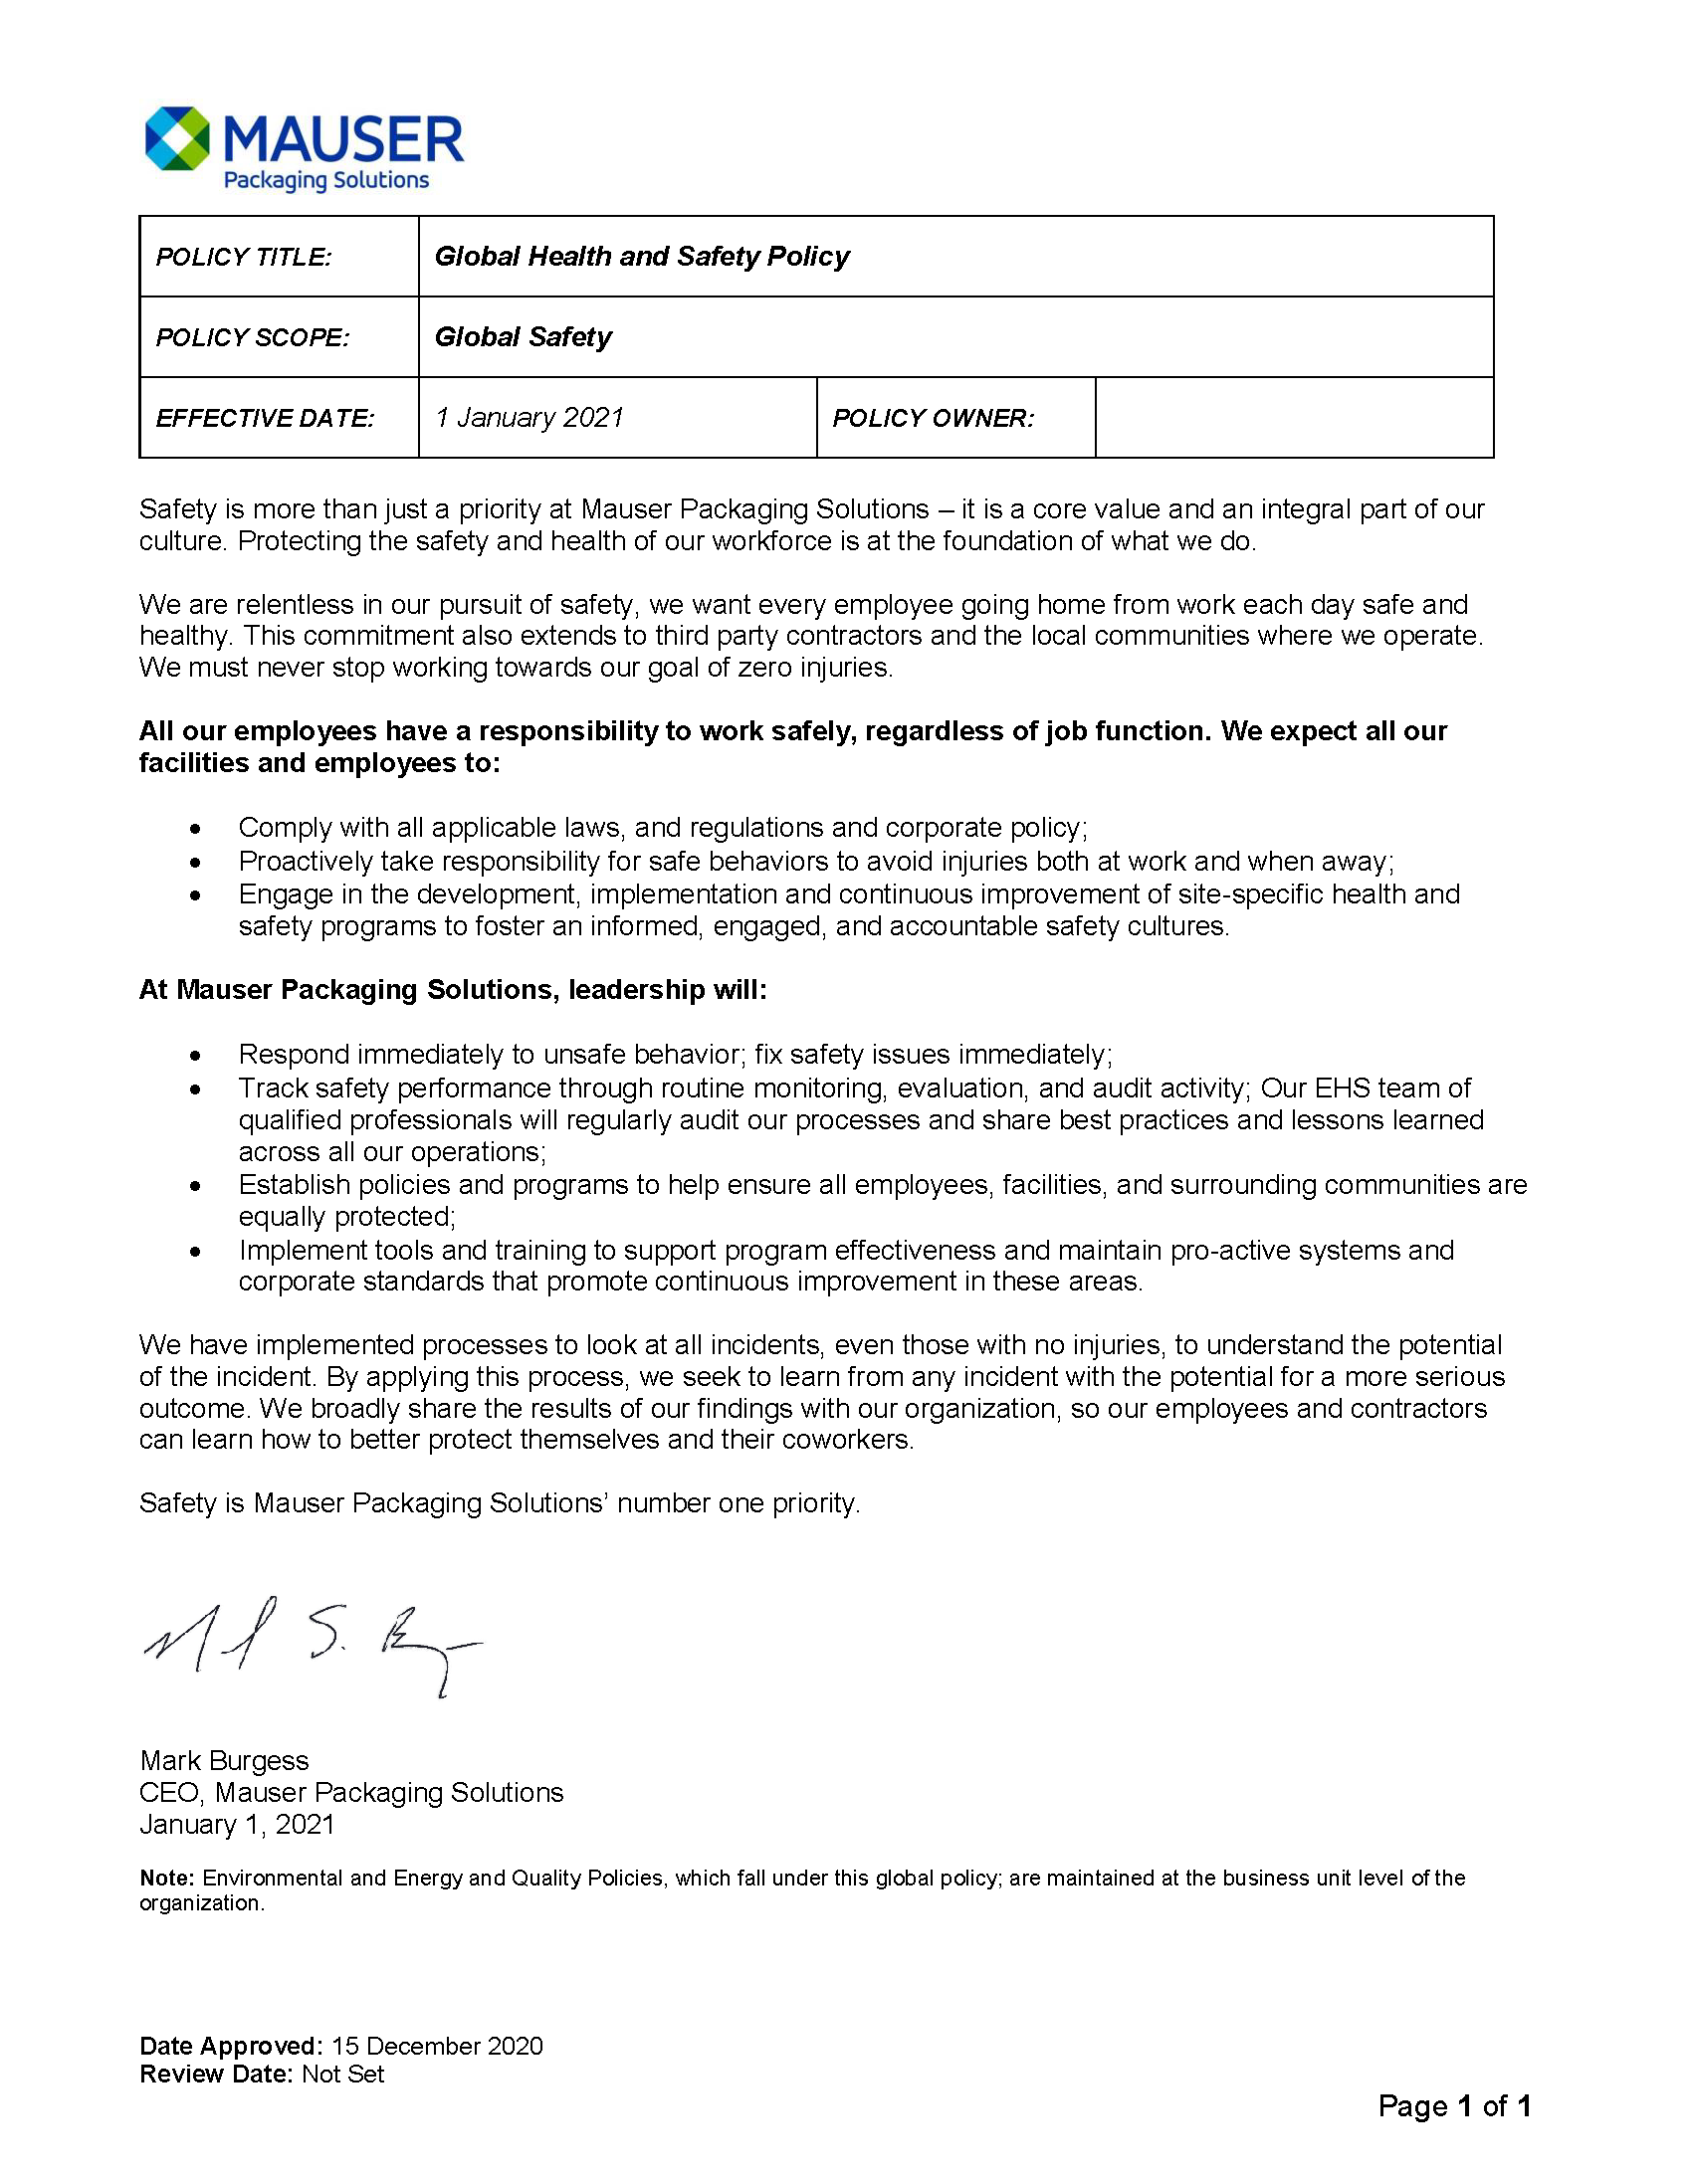
我们的安全之旅
我们的政策的亮点：
安全是核心价值，而不是优先事项。 坚持不怠是我们对安全的追求。
我们的文化不可或缺的一部分。
包括我们工作所在的社区以及承包商。
Mauser 员工以及我们经营场所的责任。
领导的责任。
事故处理，了解和改进我们的安全。
Notes:
Our first pillar is our Global Health and Safety Policy.
This policy is a recognized written statement of our commitment to protect the health and safety of employees, those we work with and our community.
Highlights of our policy:
Safety is a core value, not a priority. Relentless is our pursuit of safety.
Integral part of our culture.
Includes our community in which we work and contractors.
Our responsibility as Mauser employees along with our facilities.
Leadership’s accountability.
Incident processes, learning and evolving our safety.
Employees can access our Global Health and Safety Policy on MauserNOW and on communication boards.

Slide 12
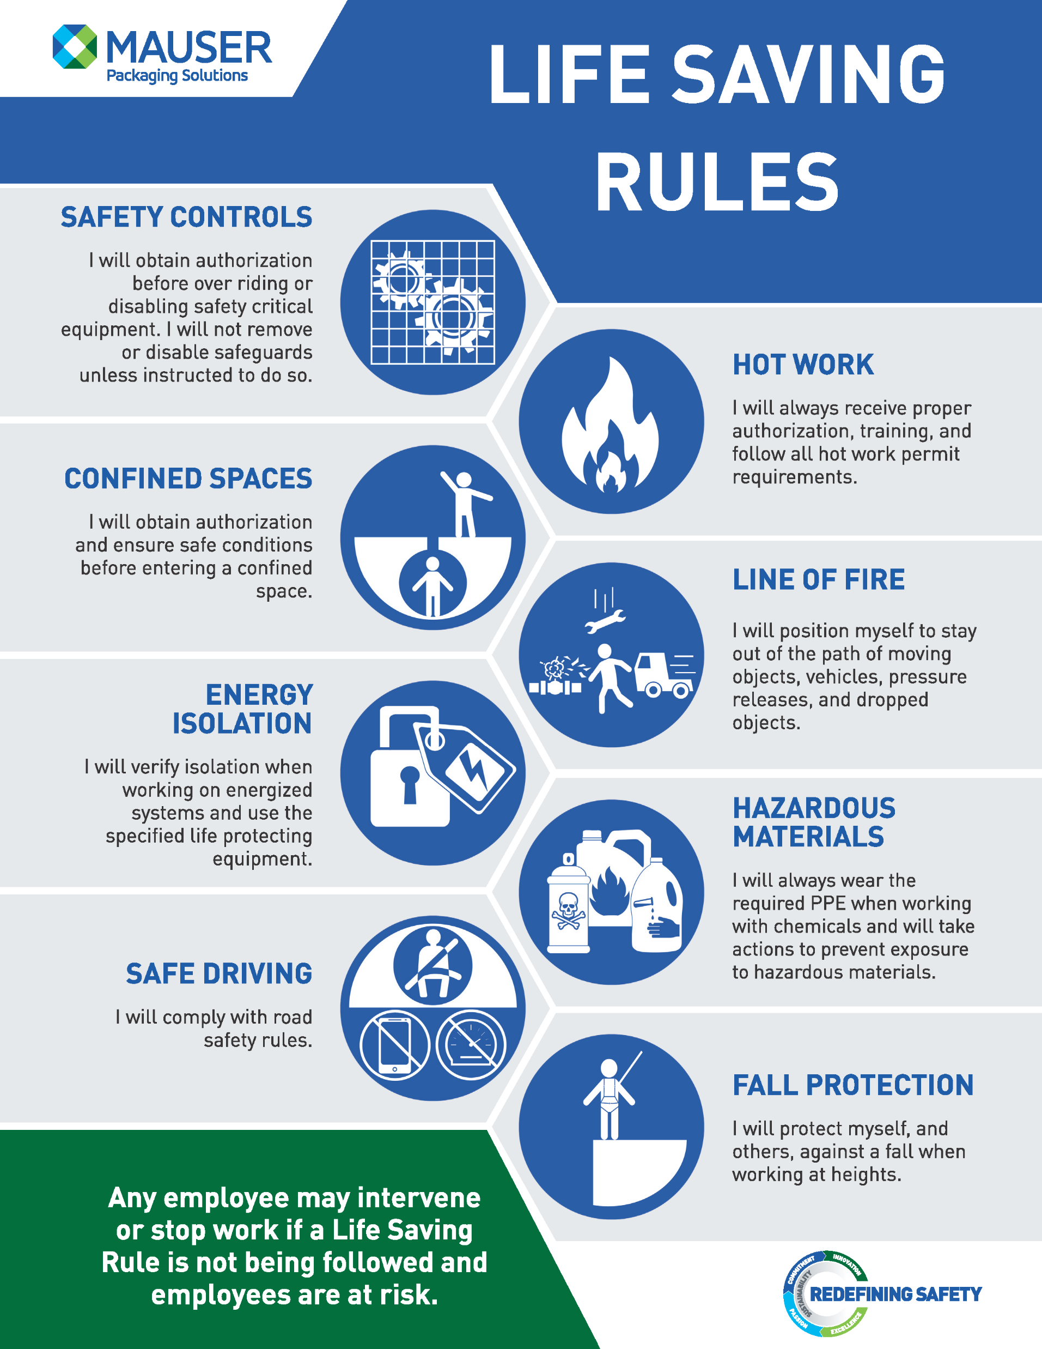
救生规则
救生规则（LSR）是关键安全原则；其可解决我们经营中特有的危险，保护我们免受严重伤亡。
Notes:
The second pillar is the Life Saving Rules which are key safety principles that address hazards specific to our operations protect us against serious injury or death.
If our policy is the statement of our commitment to safety, then the Life Saving Rules are the guiding principles of how we practice this commitment.
Implemented in 2020, the Life Saving Rules provide guidance for how all employees should act when dealing with hazardous situations or circumstances

Slide 13
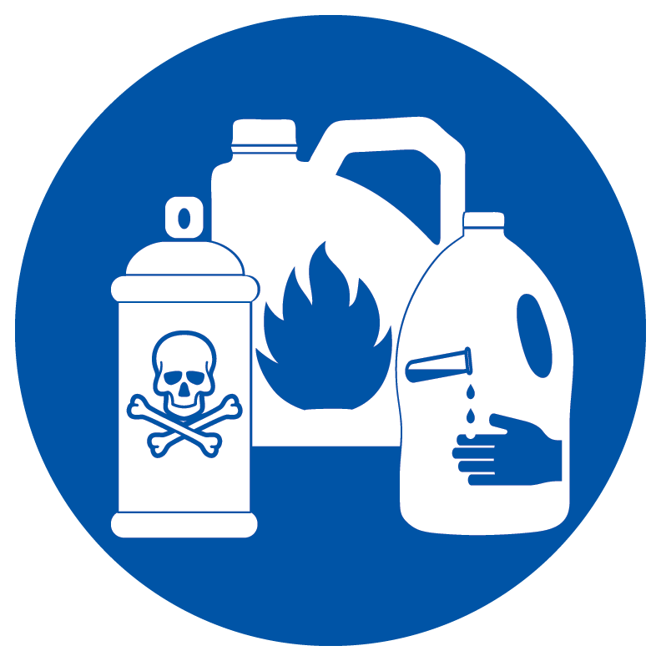
积极遵守救生规则：
教育——您有责任了解救生规则。 不懂就问！
遵守救生规则——无论职位或工作角色如何，每个人都必须遵守这些规则
风险评估——在执行任务之前，根据救生规则对任务进行审查。
干预——如果发现没有遵守救生规则并且员工处于危险之中，每个人都有权要求停止作业或活动。
积极配合 ——如果您看到同事处于危险之中，请讲出来
安全控制
封闭空间
安全驾驶
能量隔离
高温作业
火线
有害物质
坠落防护
Notes:
Leaders have a responsibility to create an environment that enforces these rules, but every employee has a responsibility for demonstrating behaviors and actions that adhere to the Life Saving Rules.
An active commitment to the Life Saving Rules includes:
Education - It’s your responsibility to understand the Life Saving Rules. If unclear, ask!
Adherence to the Life Saving Rules – everyone is required to follow these rules regardless of position or job role
Risk Assessment -Before conducting a task, review the task against the Life Saving Rules.
Intervention - Everyone has the right to request an operation or activity be stopped if they believe a Life Saving Rule is not being followed and employees are at risk.
Actively Working together - If you see a fellow worker at risk, say something
Life Savings Rules are not to be ignored or take on alternative meanings. They are to be respected, upheld and consistently executed. We are all responsible and accountable.

Slide 14
了解救生规则 (LSR)
救生规则不是
全面的安全政策
正规训练
仅用于纪律处分的惩罚性“陷阱”规则
救生规则是
最常见风险领域的提醒
处理每个风险领域所需的最基本行为的指导原则
制定保护员工免遭严重伤害或死亡的行为准则 然而，LSR 所处理的危害的严重性要求该政策包含纪律要素。

Slide 15
工作场所组织管理 – 5S
5S 系统是一个持续改进的过程，旨在提高生产率和工作场所的安全。
SORT (有序)
安全成效：
消除障碍。
减少物品碰撞、绊倒、起火，或造成其他类型的损害。 整然有序的工作场所是一个更安全的工作场所。
STANDARDIZE (标准)
安全成效：
降低故障、事故和其他安全问题的风险。
实践证明，遵循标准流程的工作场所是更安全的环境。
针对新员工的工作场所期望更高。
SET IN ORDER (确立秩序)
安全成效：
员工拿错物品的可能性更小。
用错物品会造成严重的安全风险。
SUSTAIN (维持)
安全成效：
遵循和改进 5S 方法的时间越长，设施就越安全。
持续努力的工厂会成为更安全的工作场所。
SHINE (整洁)
安全成效：
擦去灰尘和油渍可以消除火灾隐患。
清理溢出物可降低滑倒和跌倒事故的风险。
Notes:
The 5S System is a continuous improvement process designed to improve productivity that also improves workplace safety. For each step in the 5S System, there are specific safety implications that create a safer work environment when followed.
Sorting removes unnecessary items from the work area creating less clutter do there are fewer obstacles causing trips and falls.
Setting in Order makes it easier to access tools reducing the likelihood that incorrect items are used that cause safety risks.
Shining created a clean workspace free of dust and oil that create fire hazards and spills that can cause slips and falls.
Standardization ensures everyone performs tasks in the same manner and reinforces safe behavior.
Sustaining is the practice of continually re-evaluating the workspace and behavior to ensure the safest space possible.

Slide 16
工作场所组织管理 – 5S
有条不紊的工作空间的好处：
降低事故风险
更好地利用时间
减少空间浪费
减少设备停机时间
提高一致性和质量
提高士气
2023 年伤害类别
2023 年，大约 41% 的伤害发生在已通过工作场所组织管理措施提高安全的类别中。
Notes:
Having a well organized and clutter-free working space lowers the risk of accidents such as slips and trips, toppling or falling objects, and exposure to hazardous materials.
More than 60% of injuries in 2021 could have potentially been prevented with workplace organization—5S program.
An organized, clean work environment speaks to safety behavior and expectations
Clutter in the workspace causes a higher risks of slips, trips and falls along with the potential of falling objects and blind walking spots.
If the work area is disorganized, cluttered or dirty, employees can question whether leadership cares about safety and whether they should care about safety.

Slide 17
安全领导： 每个人都可以发挥作用。
Notes:
Having the elements of safety culture means nothing means nothing unless it is embodied and practiced by employees.
When it comes to safety everyone is a leader regardless or job role or title.

Slide 18
什么是安全领导？
安全领导不一定是担任领导角色的人员。
安全负责人：
展现个人安全行为
激励他人
严格遵守安全规程
以建设性的方式大胆直言
表彰以安全的方式工作的员工
倾听员工的安全顾虑
Notes:
Safety leadership does not have to be a person in a leadership role (Lead hand, Supervisor, Manager).
A safety leader is somebody who not only exhibits personal safety behaviors but inspires others to do the same. These are people who not only follow safety protocols precisely but speak up in a constructive way when they see that others could be doing something in a safer manner. They acknowledge employees working safely and take time to listen to employees’ safety concern.
Having additional safety leaders results in more sustained, consistent and positive safety performance and behaviors.

Slide 19
2024 年全球安全停工活动
根本原因分析
为什么确定根本原因至关重要？
解决问题
停止指责他人
让人们担负起责任
示例：
事故：收到超速罚单
为什么？
被抓到超速行驶
为什么？
上班迟到
为什么？
睡过头
为什么？
闹钟坏了
为什么？
电池没电了
为什么？
没换电池
解决办法：给闹钟通电 或在电池用完电之前更换电池。
加强安全措施
19
Notes:
When incidents happen, it is easy to lay blame on the specific circumstances and individual involved but most safety incidents have more than one attributing factor. When we examine incidents to discover root causes, we realize there are many opportunities to accept responsibility and effect change. A change in behavior or circumstances at any level of the root cause analysis, could have prevented the incident in question.
When we all accept responsibility for creating the environment or circumstances that facilitated an incident, we can effectuate meaningful change that ensures a safe workplace for everyone.

Slide 20
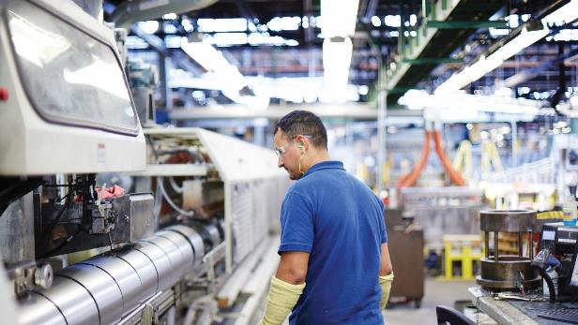
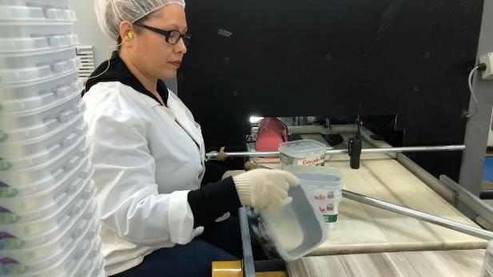
2024 年全球安全停工活动
安全人人有责
遵循程序
发挥主人翁精神
您停止工作并进行报告的权利
如果行为或环境看起来不安全，请进行干预
提出 问题以确定情况是否不安全
向经理或主管报告
安全事关个人 – 平平安安上班，顺顺利利回家！
加强安全措施
20
Notes:
While the building of a safety culture begins with leadership, everyone has a responsibility for the safety of ourselves and those around us. Each one of us shares the responsibility of making sure everyone goes home safe every day. We can achieve this by following the safety procedures that are in place and taking personal ownership for ensuring safety is the first element in every decision we make.
Every employee has the right and responsibility to stop work and report unsafe conditions or actions. Any employee can intervene and has the right to request an operation or activity be stopped if they believe a situation is unsafe and employees are at risk. If you are not sure, you should at report the situation to a supervisor or manager. If your “gut” is telling you something is unsafe, then it probably is.
Safety is personal. So personal that you take it take it home. When you are mowing the lawn or hanging Christmas lights, what safety example are you setting for your neighbors or kids? No matter where you are or what you are doing, safety matters.

Slide 21
2024 年全球安全停工活动
您将采取什么行动？
是时候……
“加强安全措施”
加强安全措施
21
Notes:
Safety must be a commitment that is made by every employee everyday and we can all do something to improve our commitment to safety. Think about your work environment and action and make a commitment to improve or change something that will help keep you and your fellow employees safer.
You will never know the injury that is prevented when you practice safety leadership.
What actions will YOU take?

